Slide 1

Cloud Computing for High Dimensional Data :
Final Project Presentation
Image Classification of Clothing
SIVAKUMAR Fabrice, OULIE Yacine

Slide 2
Outline
Dataset Presentation
Code Structure
Data Preprocessing
Training
Test
Predicted vs Actual Labels
Importance of choosing the right learning rate
Oversampling / Undersampling
Importance of preventing overfitting
Early Stopping
Dropout Layer
Conclusion and Future Work

Slide 3
Dataset Presentation

Slide 4
Dataset Presentation
A dataset of over 5,000 images of clothing items under a public domain license from Kaggle
Covers 20 different types of clothes and can be used for various purposes, including commercial use
Data collection involved three sources: Toloka (crowdsourcing platform), networking through social media, and Tagias (a company specializing in data collection)
Toloka contributed 1,400 images (28% of the dataset), but required extra analysis to filter out irrelevant or duplicated images.
Networking through social media resulted in 32 contributors submitting 600 images.
Tagias contributed the majority, providing 3,000 images (60% of the dataset), and ensured the authenticity of the images through an internal validation process.
Manual labeling of the images was done using an IPython widgets-based annotation tool.
Labeling mistakes were corrected using a simple neural network approach.

Slide 5
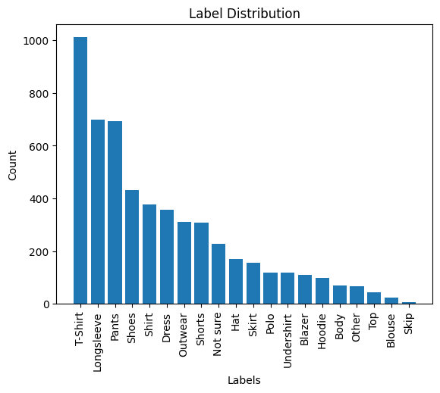
Dataset Presentation
Imbalanced dataset => Need to perform oversampling/undersampling

Slide 6
Code Structure

Slide 7
Code Structure
Data Preprocessing
Training part involving a training set and validation set (fine tune the learning rate)
Test part gives a percentage of the model accuracy
Predicted vs Actual Labels part

Slide 8
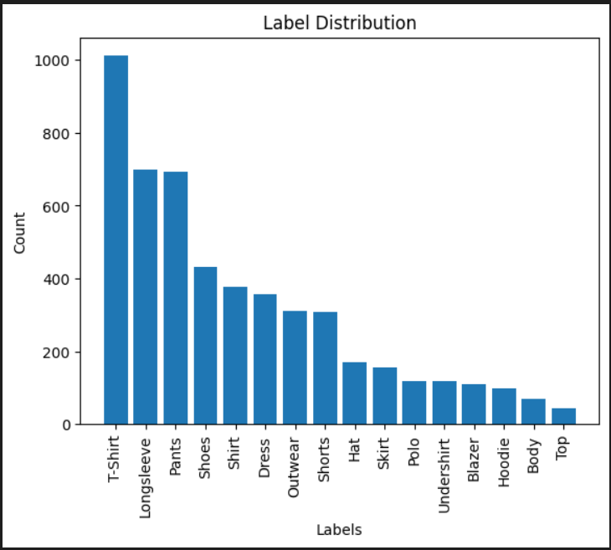
Data Preprocessing
Elimination of corrupted images from the dataset.
Elimination of 2 classes(‘Others’ and ‘Not Sure’) for image classification.
Exclusion of 2 classes(‘Skip’ and ‘Blouse’) due to unclear and difficult-to-recognize images.
Creation of a Python dictionary for label encoding, assigning a unique number to each label.

Slide 9
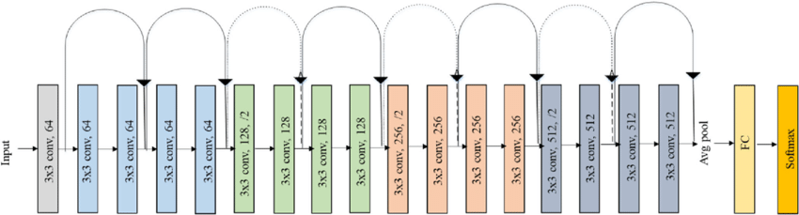
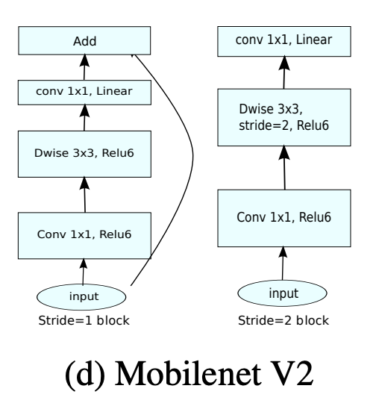
Training
Resnet18
MobileNetV2

Slide 10
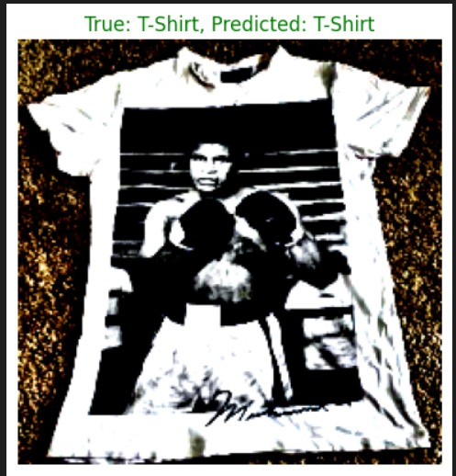
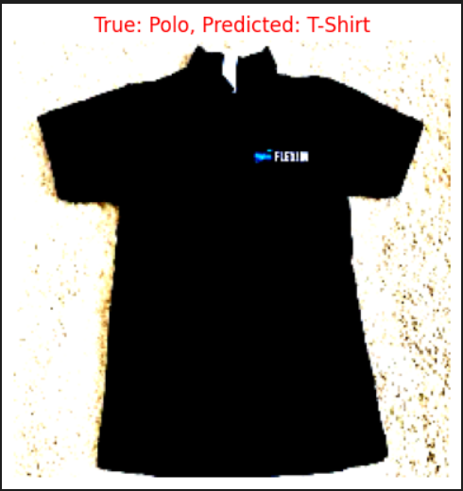
Predicted vs Actual Labels
We take 10 random images from the test set and compare the predicted label and the actual labels
Green when it’s the same
Red otherwise

Slide 11
Importance of choosing the right learning rate

Slide 12
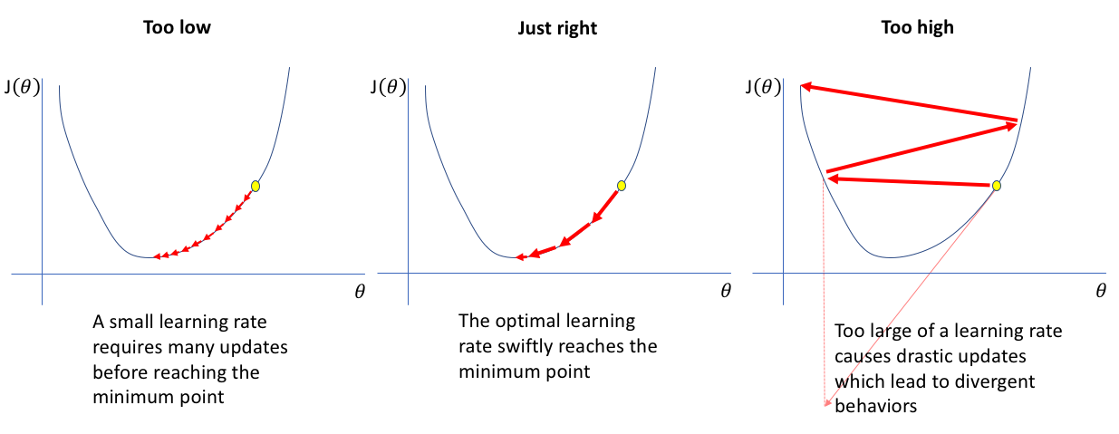
Importance of choosing the right learning rate

Slide 13
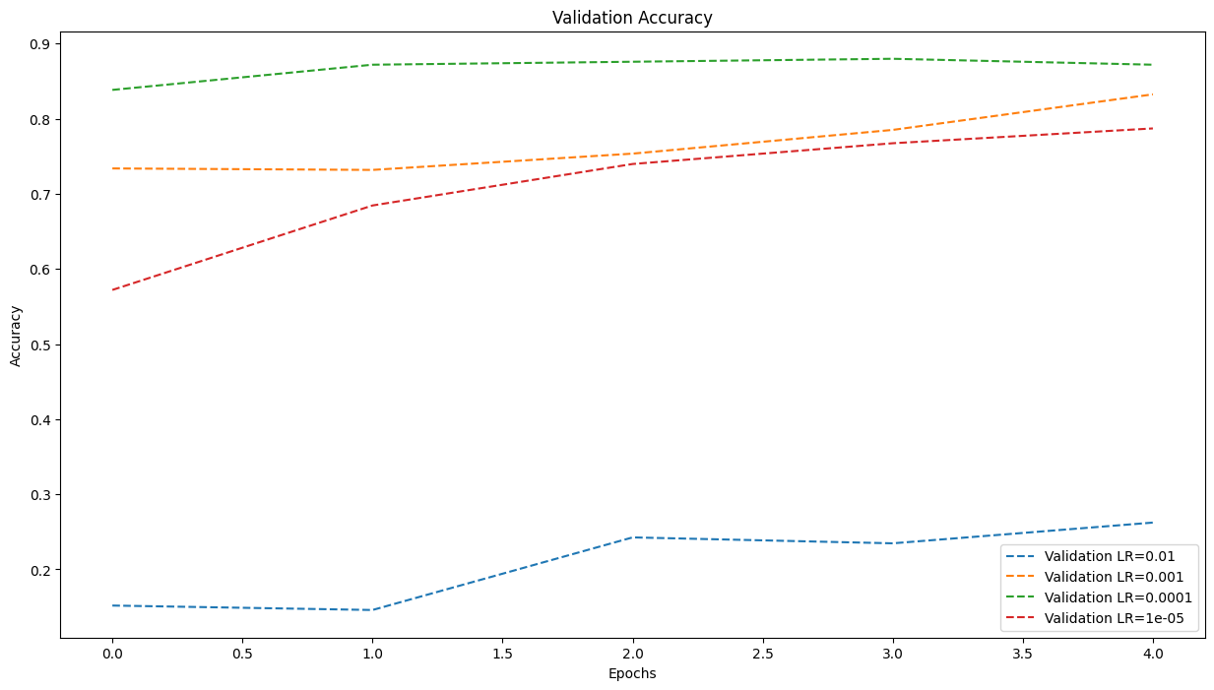
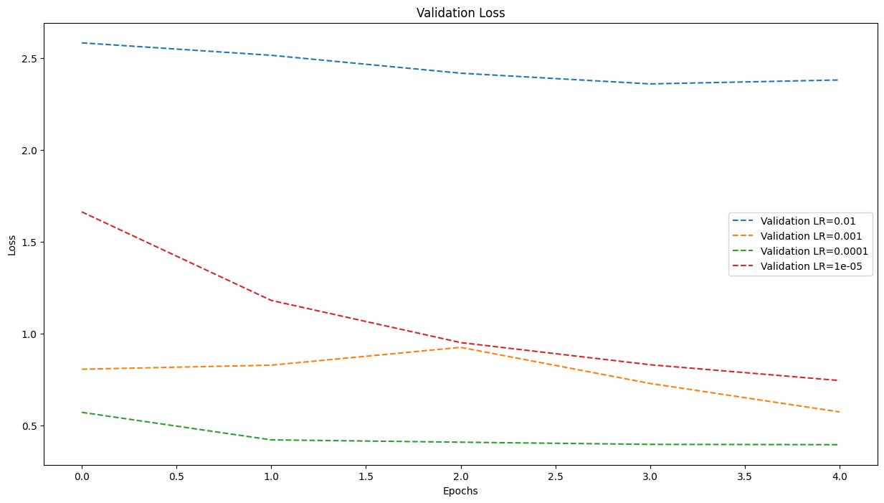
Importance of choosing the right learning rate
The best learning rate among these four rates to choose is 1e-4

Slide 14


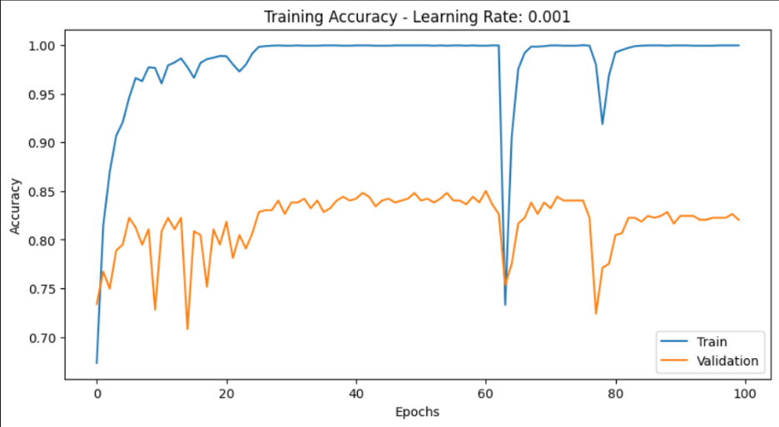
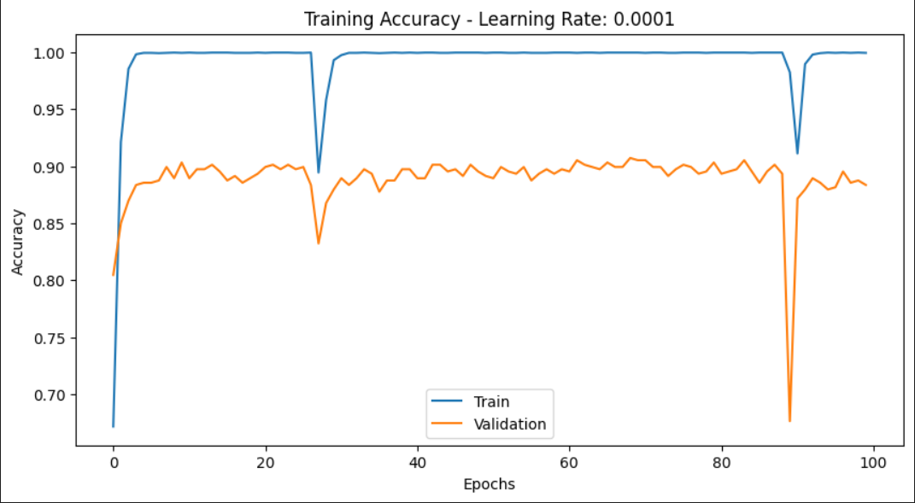
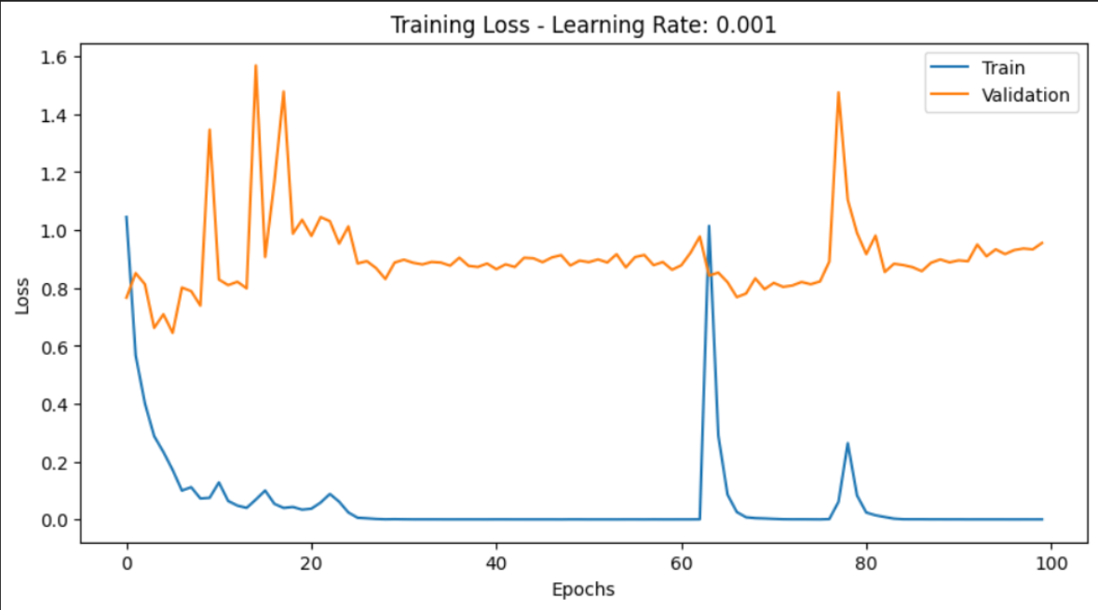
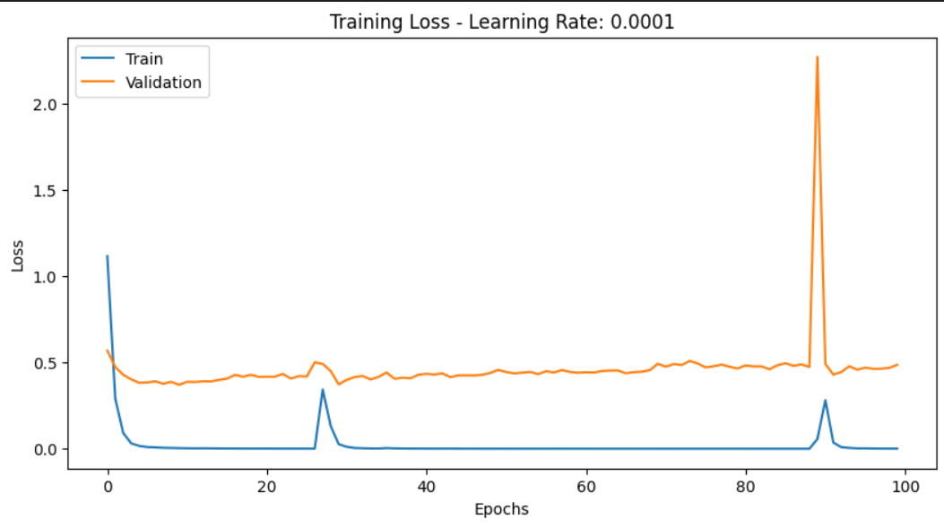
Importance of choosing the right learning rate

Slide 15
Oversampling/Undersampling

Slide 16
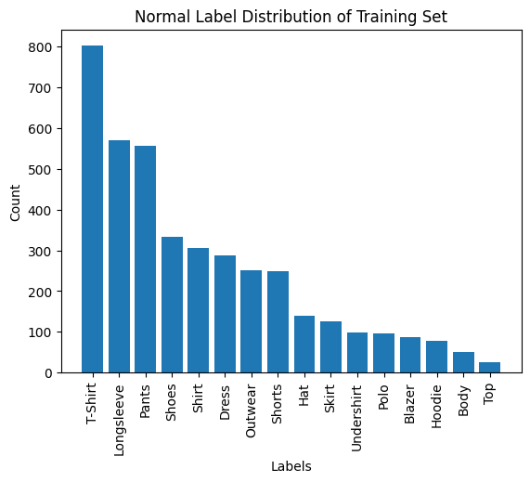
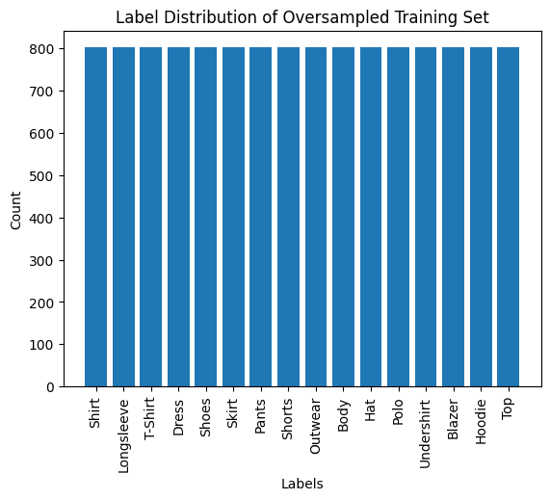
Oversampling/Undersampling
To tackle the imbalance issue in the dataset that can affect the training of the model :
Oversampling
Undersampling
Oversampling + Undersampling
Oversampling
Oversample the minority classes in the training set
‘RandomOverSampler’ function from imblearn library
Use of ‘not majority’ sampling strategy => all except the majority class
Select instances randomly from the minority classes and create duplicates of the selected instances.

Slide 17
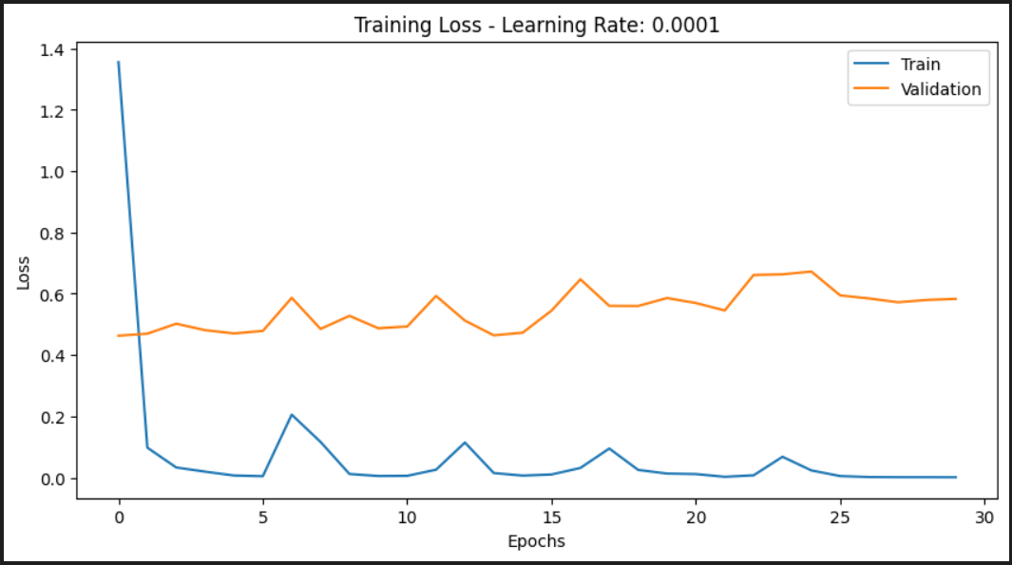
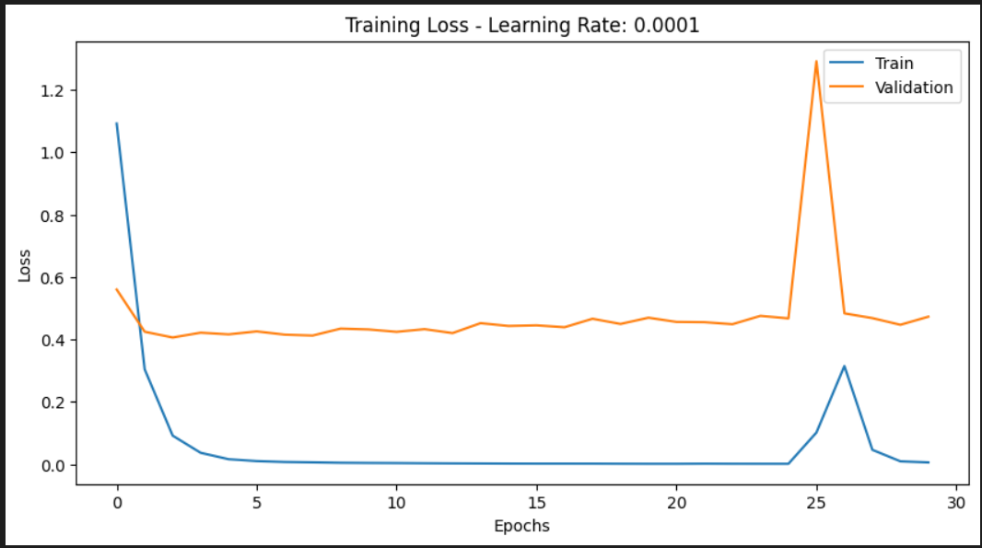
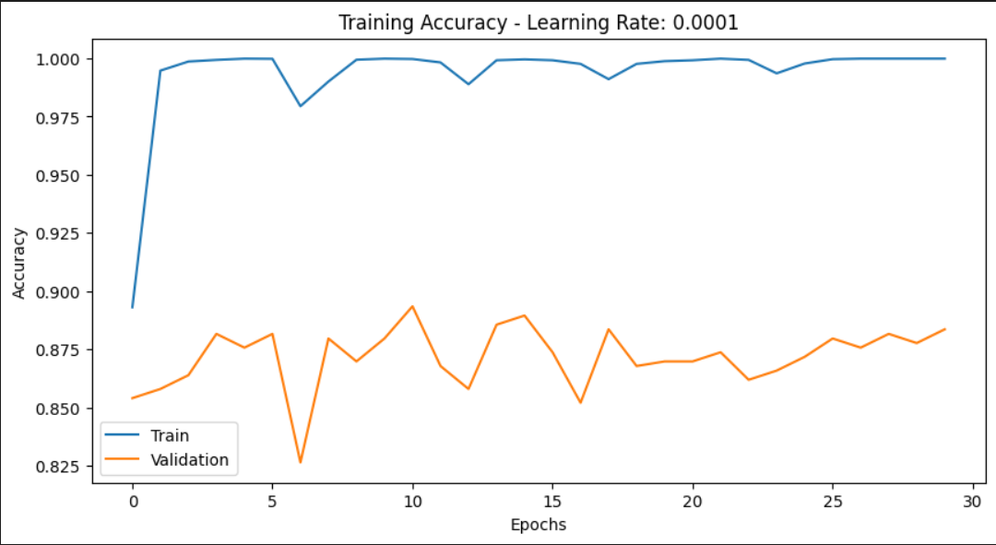
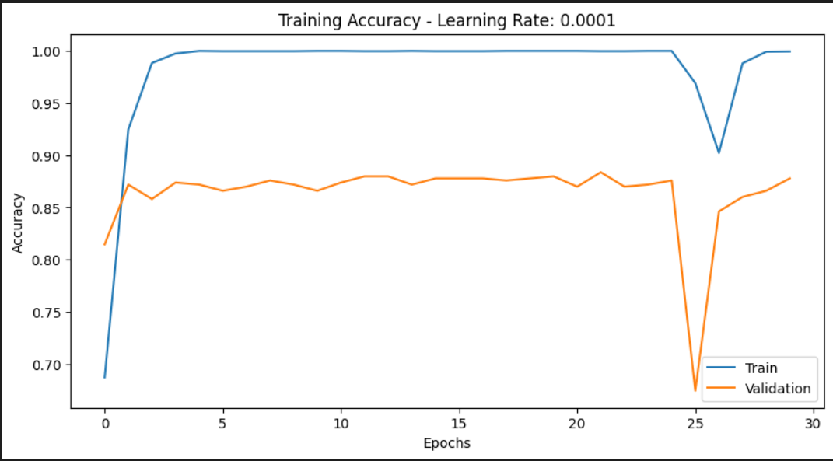

Oversampling / Undersampling
With Oversampling
Without Oversampling
Advantages :
No more big fluctuations
Less losses
Drawbacks:
Accuracy in test set is smaller with oversampling but with 100 epochs it could be different
Longer training time

Slide 18
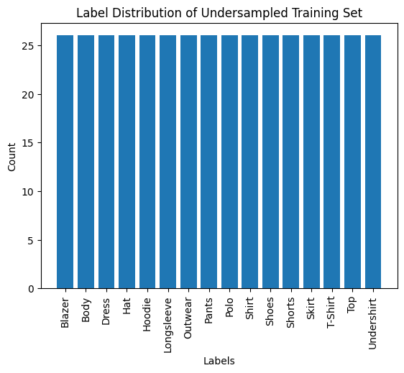
Oversampling/Undersampling
Undersampling
Undersample the majority classes in the training set
‘RandomUnderSampler’ function from imblearn library
Use of ‘not minority’ sampling strategy => all except the minority class
Select instances randomly from the majority classes to create a subset, discarding the rest.

Slide 19
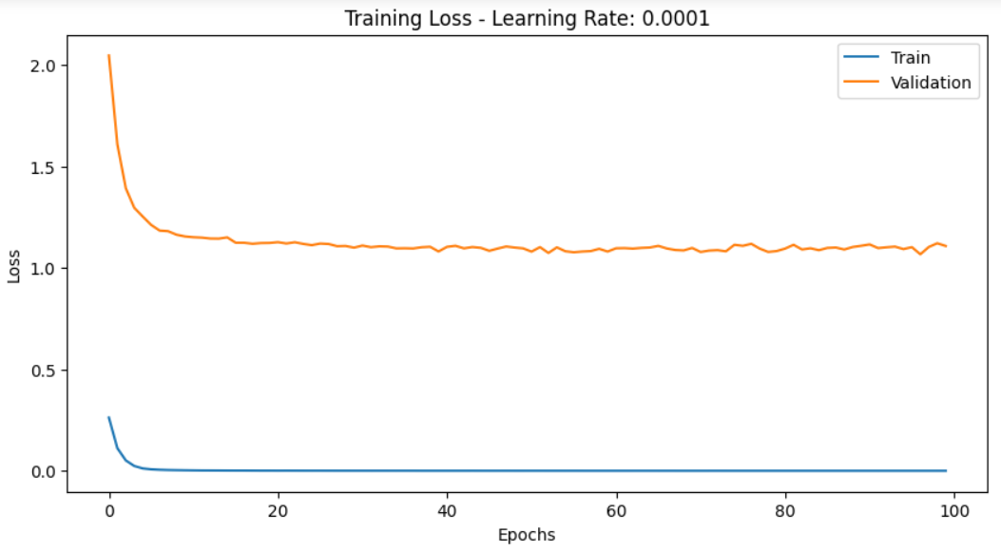
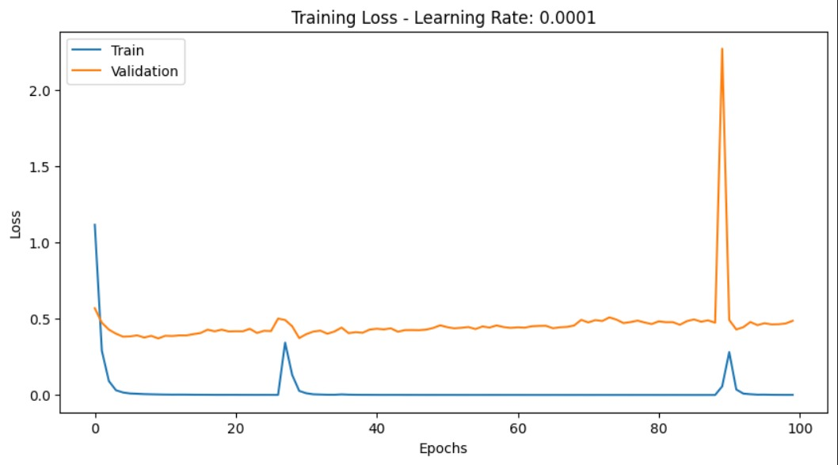
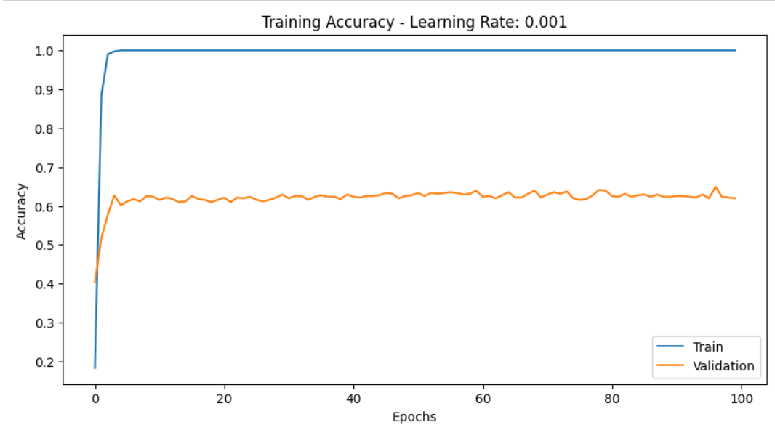
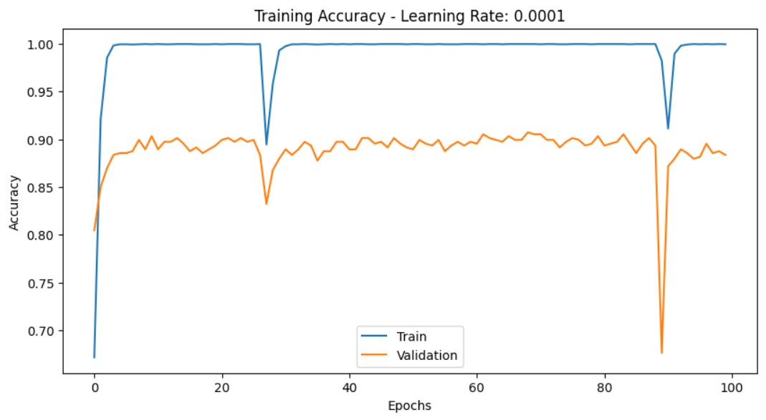
Oversampling/Undersampling
With Undersampling
Without Undersampling
Advantages :
No more big fluctuations
Take less time to train
Drawbacks:
Accuracy in test set is smaller with undersampling
Big losses and small accuracy in validation set => lost important information of the majority classes

Slide 20
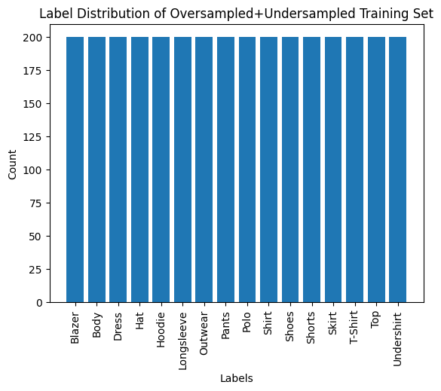
Oversampling/Undersampling
Oversampling + Undersampling
Oversample the minority classes in the training set
Undersample all classes in the training set to have a smaller amount in each class

Slide 21
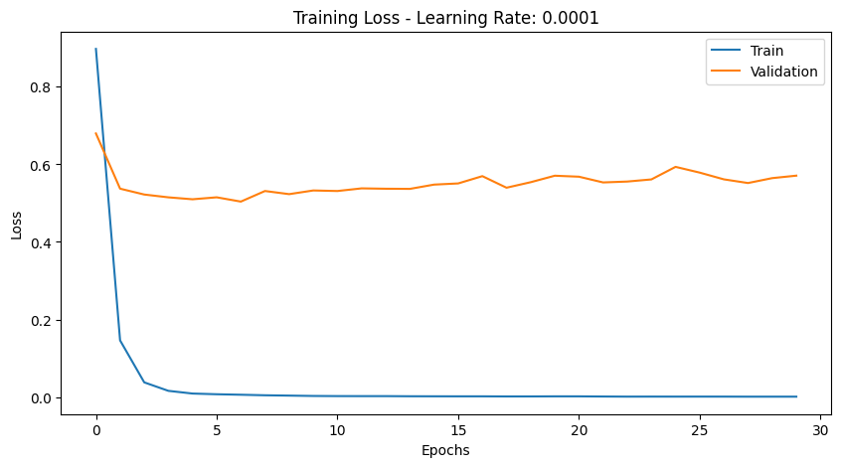
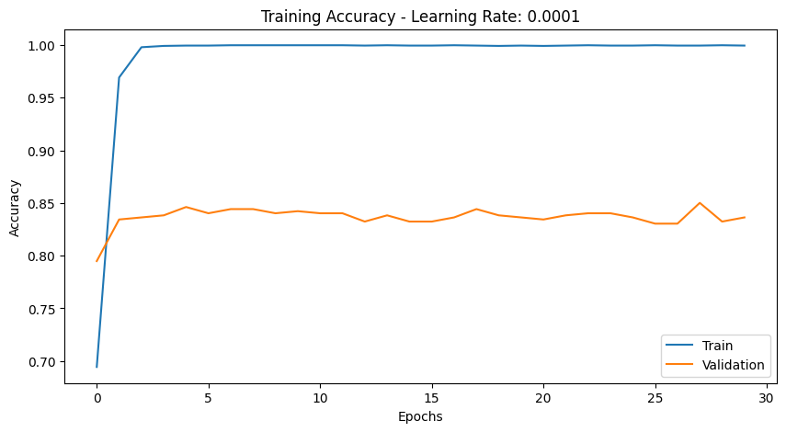
Oversampling/Undersampling
With Oversampling + Undersampling
Without Oversampling +Undersampling
Advantages :
No more big fluctuations
Less losses depending on the number of elements we choose for each class
Drawbacks (depending on the number of elements we choose for each class):
Accuracy in test set is smaller with undersampling
Big losses and small accuracy in validation set => lost important features of the majority classes
Can take more time to train the model depending on the number of elements we choose for each class
Oversampling is the best solution to generalize a model

Slide 22
Importance of preventing overfitting

Slide 23
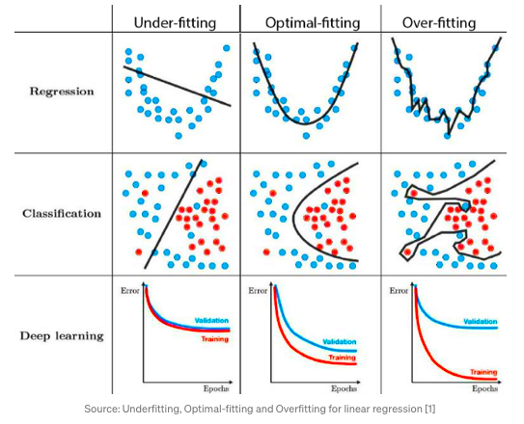
Importance of preventing overfitting
Overfitting:
Definition:
Model learns training data too well, capturing noise and outliers.
Characteristics:
Low training error but high validation error.
Model overly complex.
Risks:
Poor generalization to new/unseen data.
Sensitivity to noise in training data.
Limited model applicability.

Slide 24
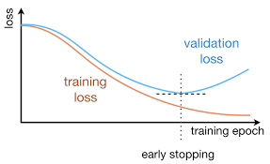
Early Stopping
Purpose:
Prevent overfitting during model training.
Mechanism:
Monitors a specified metric (e.g., validation loss) during training.
Stops training once the metric stops improving or starts degrading.
Helps find the optimal point to halt training, avoiding overfitting.
Implementation
Compare last validation loss with the best validation loss (best_val_loss).
Update or Increment:
If current validation loss is better, update best_val_loss and reset counter (epochs_without_improvement).
If not, increment the counter.
If counter surpasses patience threshold (patience), exit training loop.

Slide 25

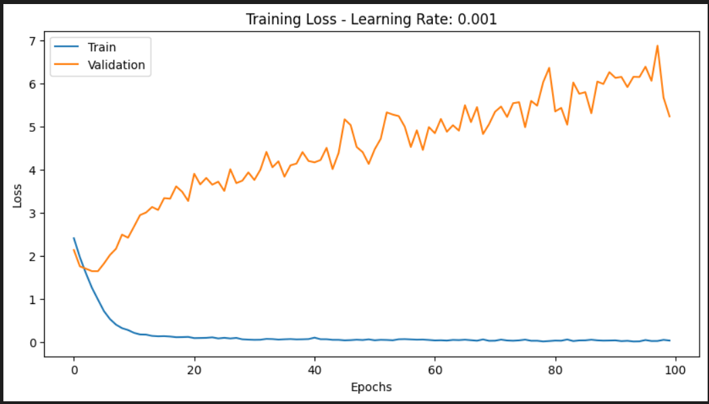
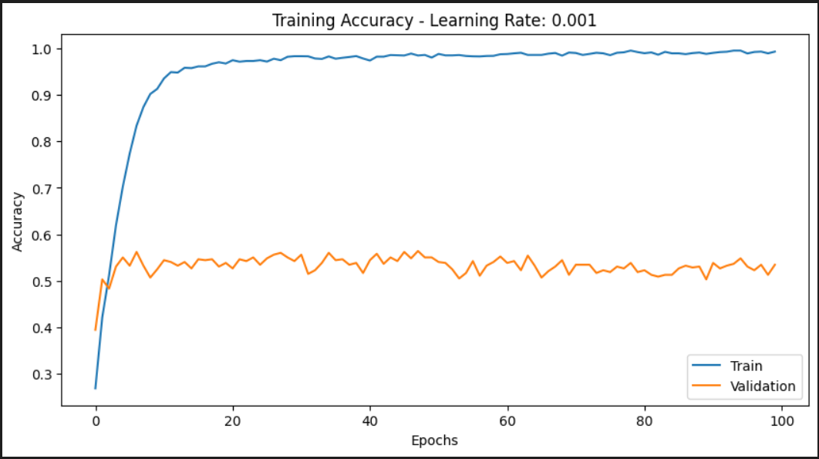
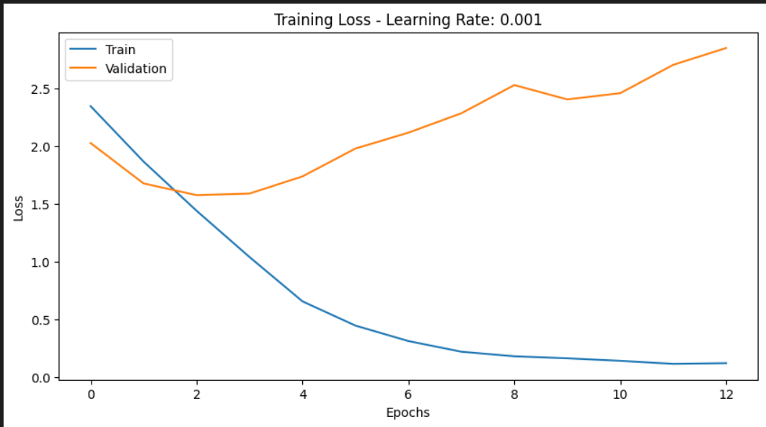
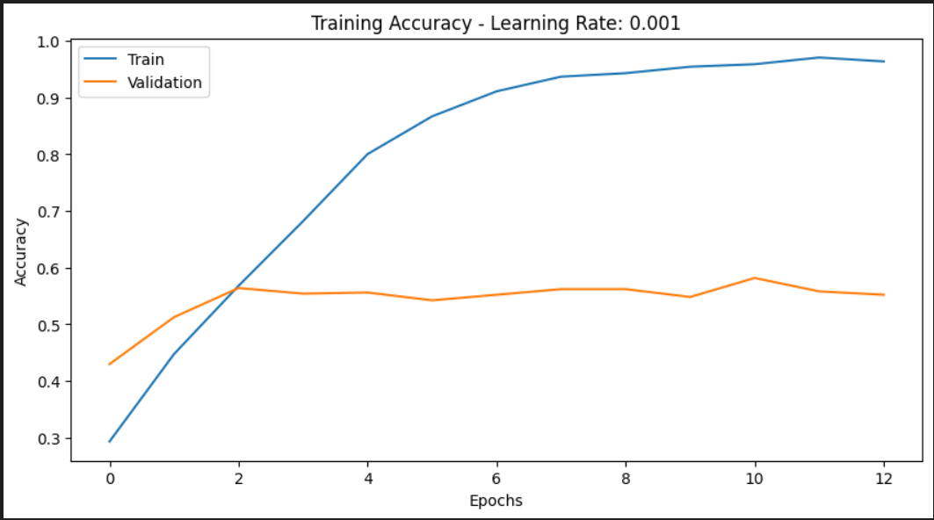
Early Stopping
An example from our experiments where the Early Stopping was useful (our model training) :
Without Early Stopping
With Early Stopping

Slide 26
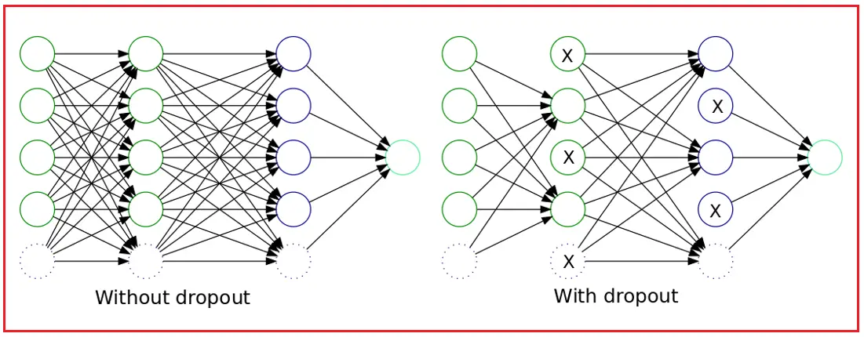
Dropout layer

Slide 27
Conclusion & Future Work

Slide 28
Conclusion & Future Work
Successful Results with Pretrained Models: Achieved excellent results, particularly with the ResNet18 pretrained model and to a lesser extent with MobileNetV2. The primary focus of our testing and experimentation was on ResNet18.
Effective Handling of Imbalanced Dataset: Identified oversampling as the most effective method to address fluctuations resulting from the imbalanced nature of the dataset. Oversampling proved beneficial in improving the model's ability to generalize across different classes.
Challenges with Custom Model: Attempted to create a custom model, but encountered performance issues, reflected in a poor accuracy. However, the implementation of early stopping proved crucial in preventing overfitting and stabilizing the training process.
Recommendations for Future Work: Suggested future work involves exploring more complex architectures and incorporating dropout layers. With additional time and resources, it is expected that these enhancements could lead to improved model performance

Slide 29
Thank you for your attention !

